Slide 1


Slide 2
Testing cloud and kubernetes applications
Micael Gallego &
Patxi Gortázar
https://elastest.io/expoqa19

Slide 3










About us
developers
university professors
trainers, consultants
@micael_gallego
@fgortazar
micael.gallego@urjc.es
francisco.gortazar@urjc.es
@micaelgallego
@gortazar

Slide 4




SOFTWARE
LABORATORY
PRODUCTS
MASTER CLOUD APPS
CONSULTANCY & TRAINING
Software quality
Backend technologies
Cloud & containers
CI / CD
Cloud Computing & Microservices
Testing / Git / Jenkins / CI
Web Technologies & APIs
Extreme Programming
Concurrent & Distributed Systems
Software Architecture
100% Online / 1 año
http://codeurjc.es

Slide 5
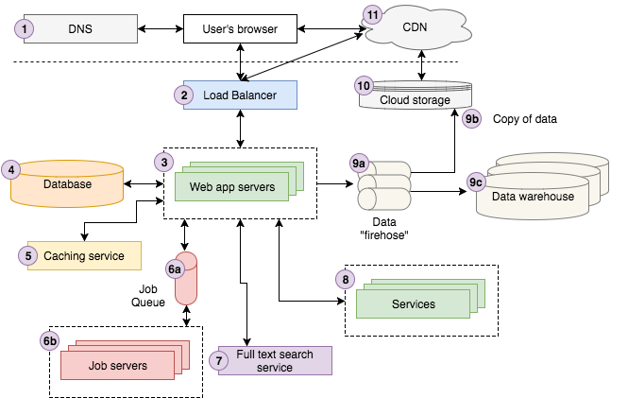
Cloud native applications

Slide 6
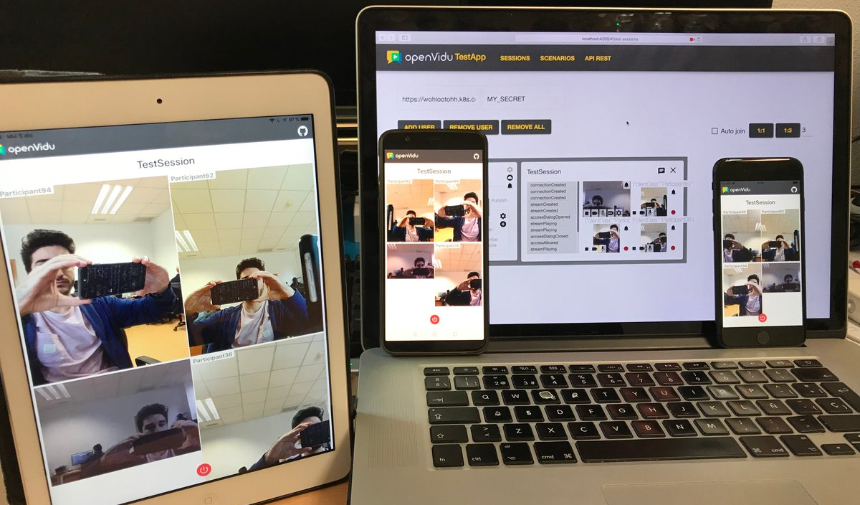

Slide 7
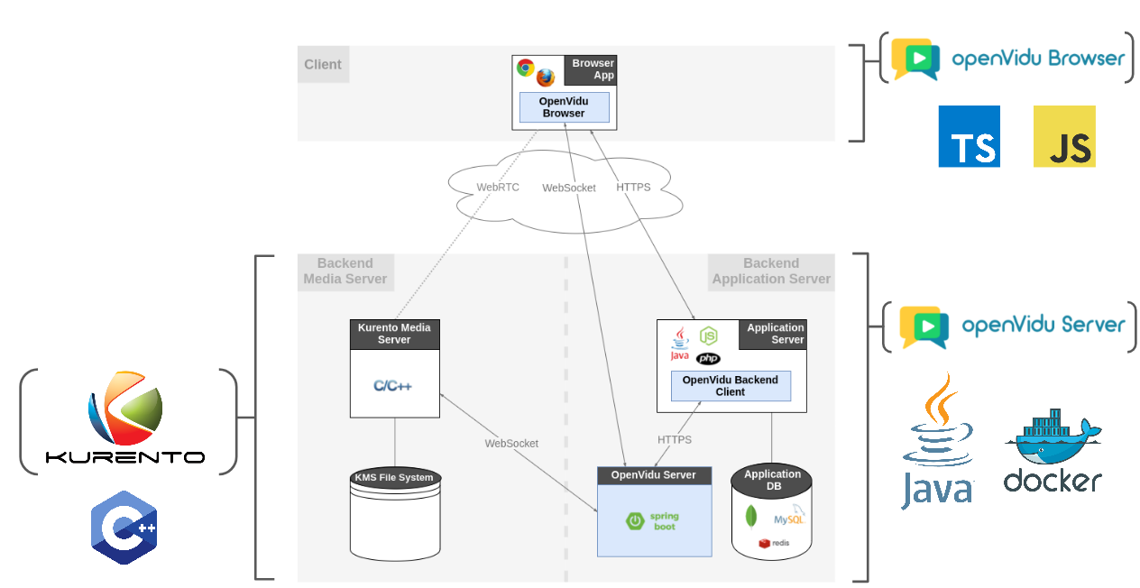
Cloud native applications

Slide 8
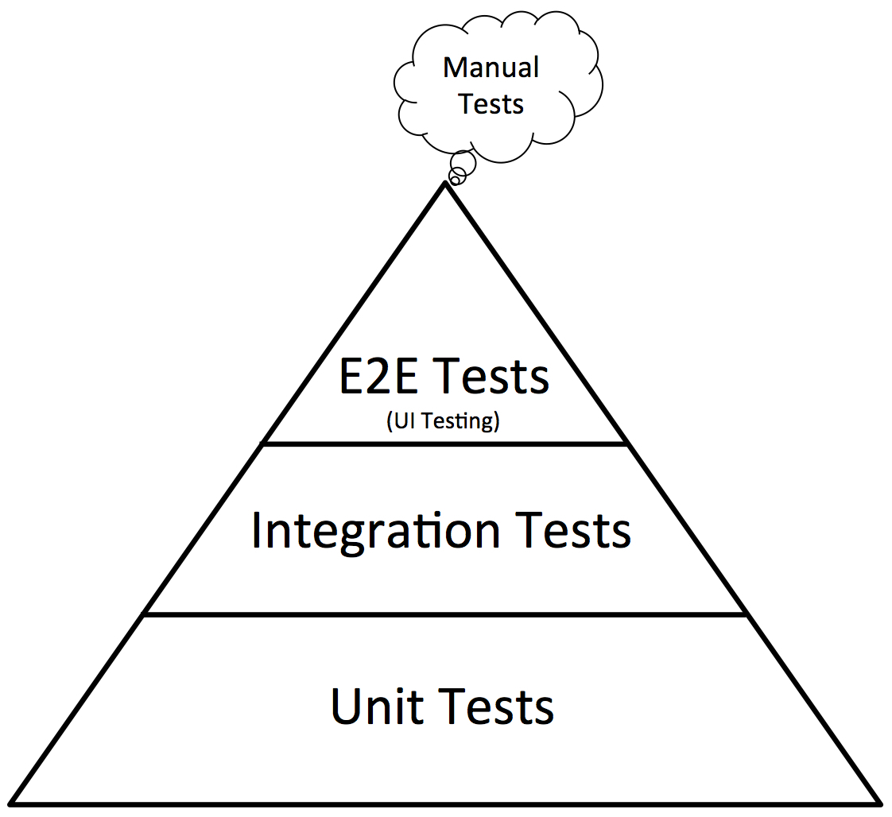
Testing
We need tests to assure their quality

Slide 9
Testing
E2E testing of complex cloud native apps is a big challenge

Slide 10
How’s the testing process?

Slide 11
How’s the testing process?
Fixing
Fix the error on the faulty component and any other components that might be affected by these changes. Submit the changes and re-start the process.
03
Testing activities
Automated or manual testing activities.
Collect information about the running components during the test run.
01
02
Bug localization
Find the faulty component(s) out of the information provided by the failed test.

Slide 12
How’s the testing process?
Fixing
Fix the error on the faulty component and any other components that might be affected by these changes. Submit the changes and re-start the process.
03
Testing activities
Automated or manual testing activities.
Collect information about the running components during the test run.
01
02
Bug localization
Find the faulty component(s) out of the information provided by the failed test.

Slide 13
Solution:
Observability + Analytics!!

Slide 14
“In control theory, observability is a measure of how well internal states of a system can be inferred from knowledge of its external outputs.”
(Wikipedia)

Slide 15
This is what we usually do in production

Slide 16
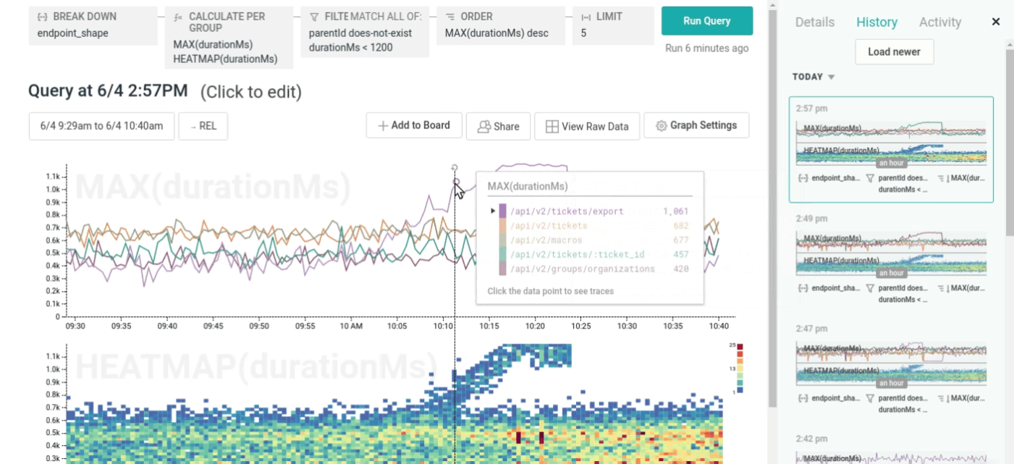
Source: honeycomb.io

Slide 17
How to know the root cause of the problem when an e2e test fails?

Slide 18
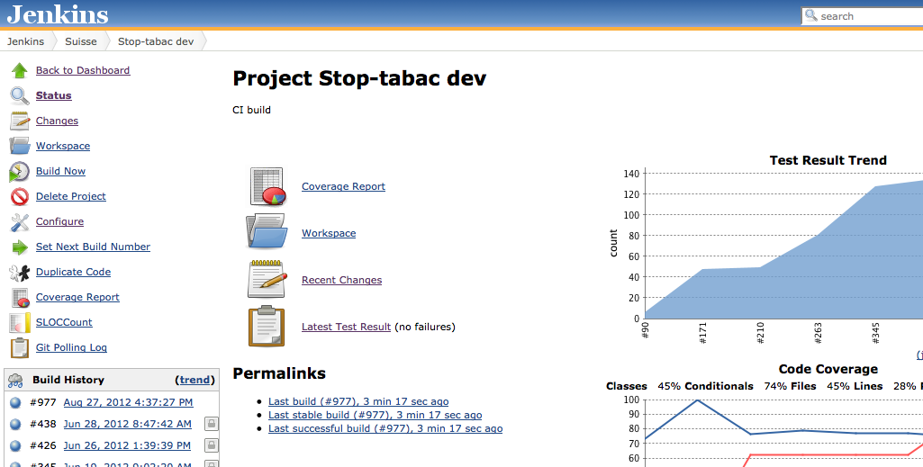

How CI server help us?

Slide 19
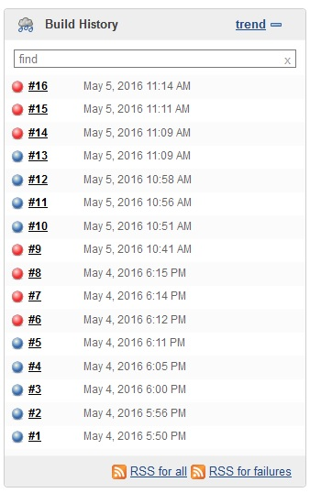
Build history

Slide 20
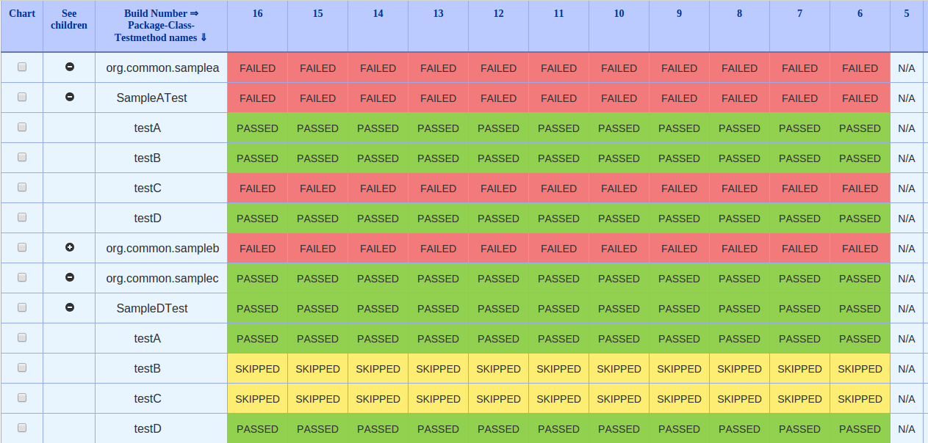
Build history divided by tests

Slide 21
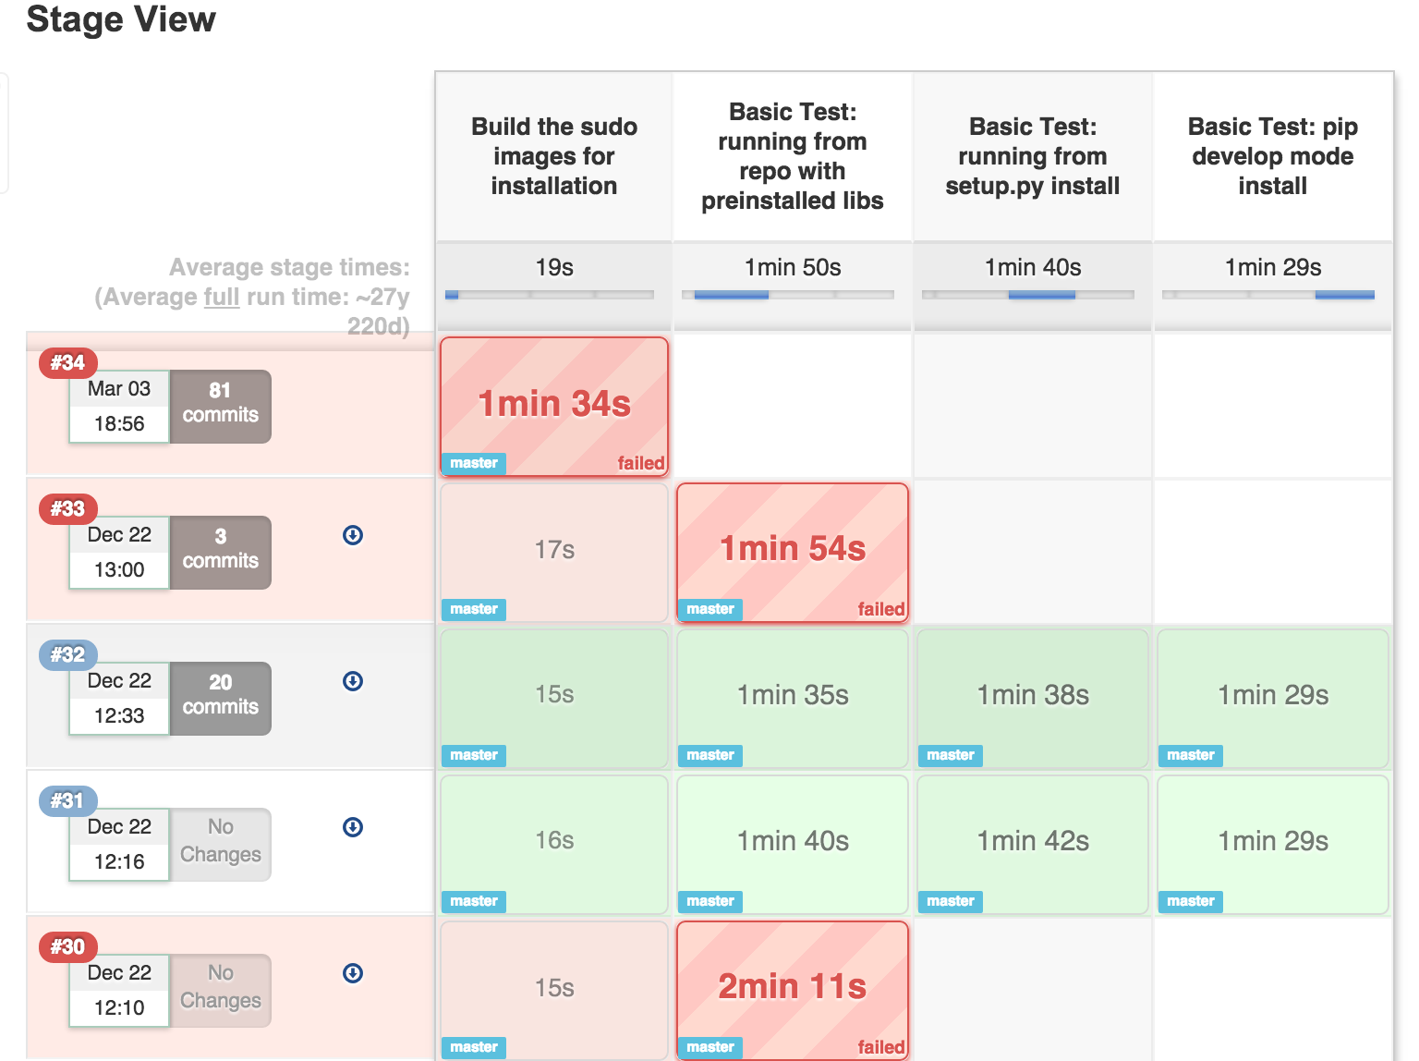
Build history divided by job steps

Slide 22
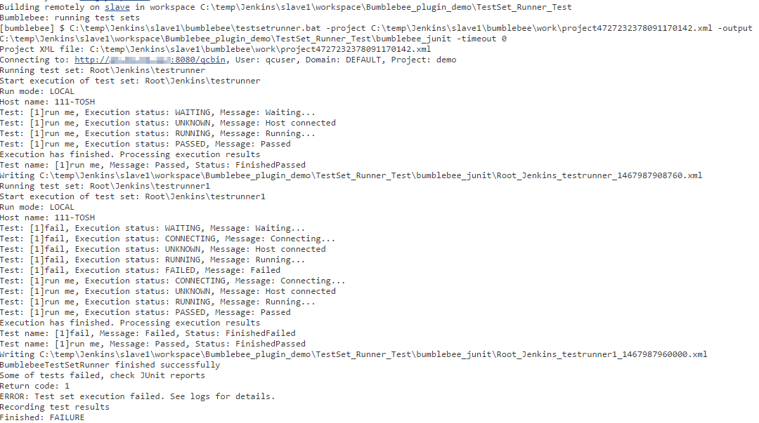
Job execution logs

Slide 23
Limitations of logs in CI Servers
One huge log for all job execution
  Dependencies downloading
  Compiling process
  Package process
  System deploying
  Finally…. test logs!

Slide 24
Limitations of logs in CI Servers
Some test frameworks don’t log when every individual test starts and ends in the job log
  Is difficult to know the logs belonging to failed test
  Developer has to include marks in the code
  JUnit4 → @Rule
  JUnit5 → @ExtendWith

Slide 25
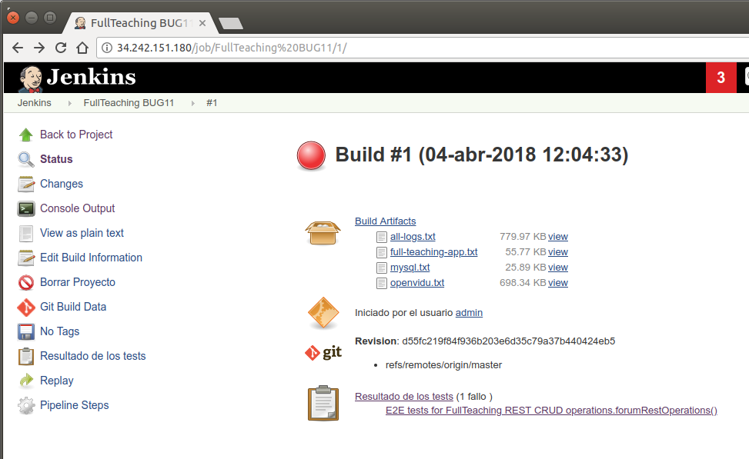
Limitations of logs in CI Servers
Some testing frameworks add test log in test report file and it is show in test page

Slide 26
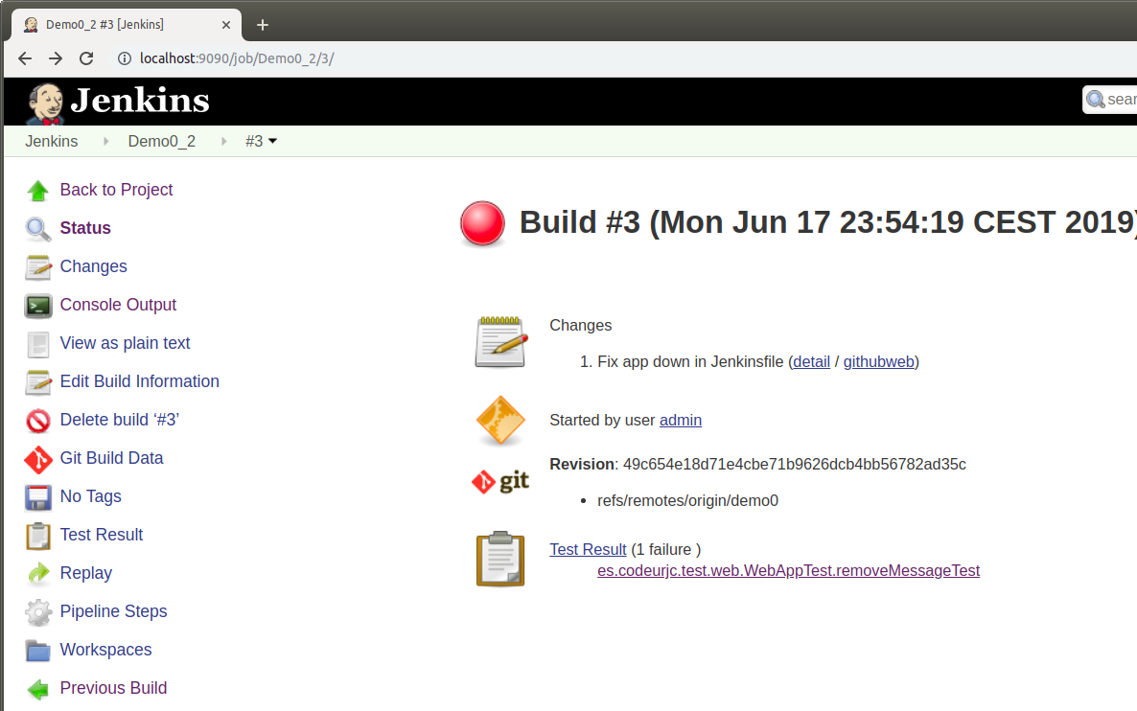
Limitations of logs in CI Servers
Some testing frameworks add test log in test report file and it is show in test page

Slide 27
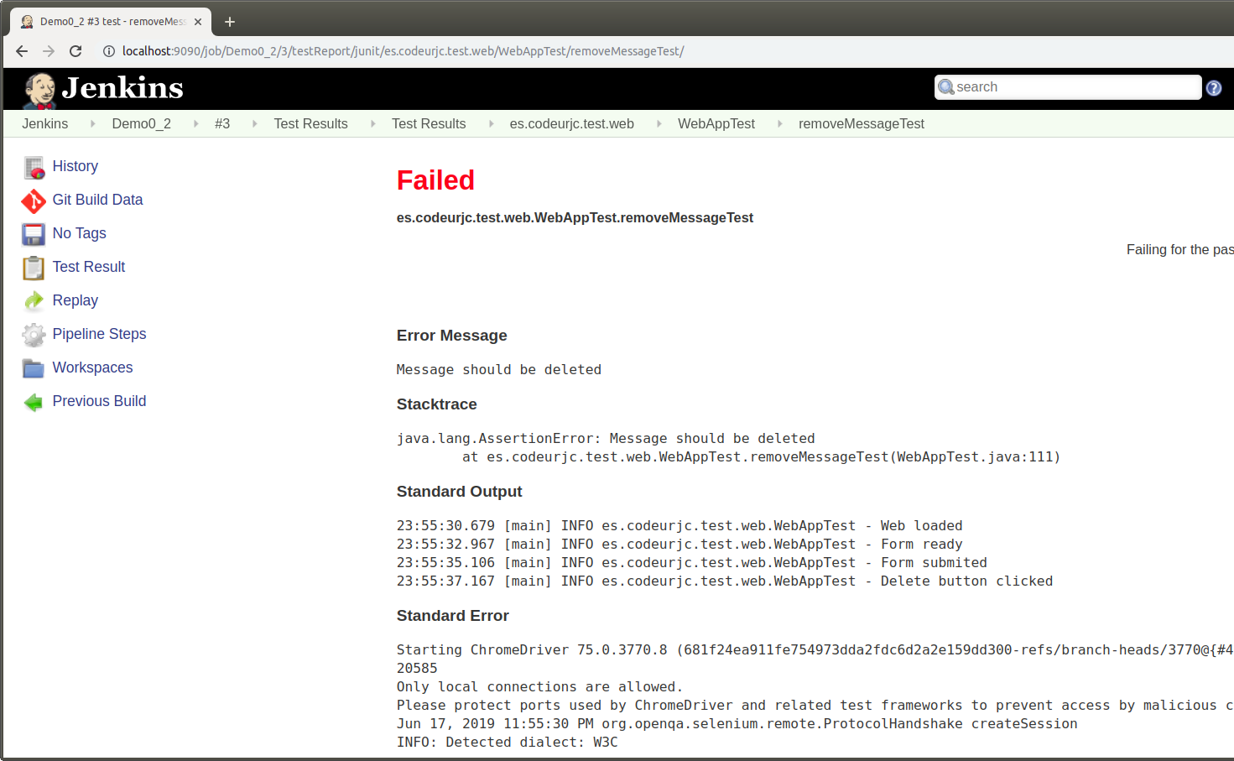
Limitations of logs in CI Servers
Some testing frameworks add test log in test report file and it is show in test page

Slide 28
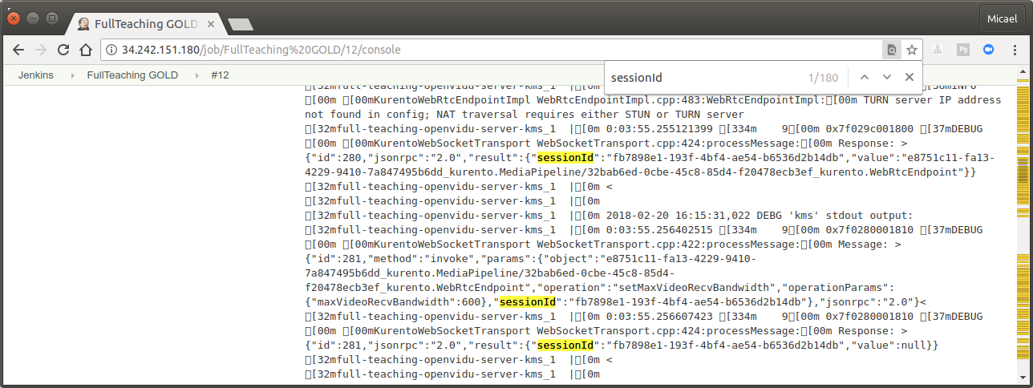
How do you analyze job log?
Using browser search tools (very limited)

Slide 29

Demo 0
Basic web app with database
https://github.com/codeurjc/expoqa19/tree/demo0

Slide 30

Very basic SUT with 2 services
http://localhost:8080
Puerto
8080
Java
Web app
container
Puerto
3306
MySQL
container
Browser
docker-compose

Slide 31
Very basic SUT with 2 services
Jenkinsfile
  1) Clone repository
  2) Build app
  3) Start app
  4) E2E tests
  5) Shutdown app

Slide 32
Retrieving SUT Logs
node {
try {
stage("Preparation") {
git(
url: 'https://github.com/codeurjc/expoqa19.git',
branch: "demo0"
)
}
stage("Create jar") {
sh "docker-compose build"
}
stage("Start app") {
sh "docker-compose up -d"
}
stage("Test") {
sh "mvn test"
}
} finally {
sh "docker-compose down"
junit "target/*-reports/TEST-*.xml"
}
}
Clone repository
Jenkins Job with Java SUT
  Clone repository
  Create SUT .jar
  Start .jar execution (gathering logs)
  Execute tests against SUT
  Sutdown SUT
  Archive logs
  If success, archive .jar
Build app
Start app
E2E Tests
Shutdown app
https://github.com/codeurjc/expoqa19/blob/demo0/Jenkinsfile

Slide 33
Where are SUT logs?

Slide 34
Limitations of logs in CI Servers
Where are the SUT logs?
  In e2e tests, usually Jenkins only executes tests.
  SUT is executed elsewhere:
    Cloud instances
    Containers (Kubernetes, docker-compose…)
    Plain old .jars?
  This logs have to be retrieved, stored...

Slide 35
Demo 1
Get and archive SUT logs
https://github.com/codeurjc/expoqa19/tree/demo1

Slide 36
node {
try {
stage("Preparation") { ... }
stage("Create jar") { ... }
stage("Start app") { ... }
stage("Test") { ... }
} finally {
sh "docker-compose logs > all-logs.txt"
archive "all-logs.txt"
sh "docker-compose logs web > web-logs.txt"
archive "web-logs.txt"
sh "docker-compose logs db > db-logs.txt"
archive "db-logs.txt"
sh "docker-compose down"
junit "target/*-reports/TEST-*.xml"
}
}
Archive logs as files
https://github.com/codeurjc/expoqa19/blob/demo0/Jenkinsfile

Slide 37
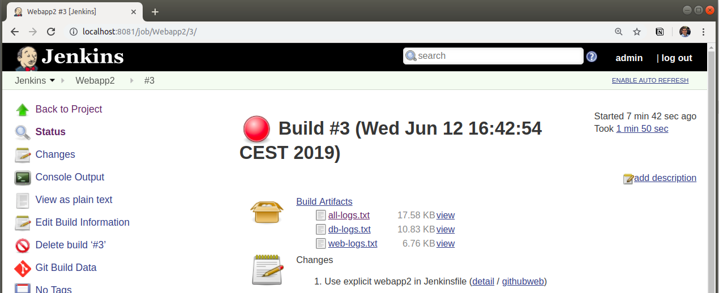
SUT Logs are available as a text files
One file for all logs
One file per component

Slide 38
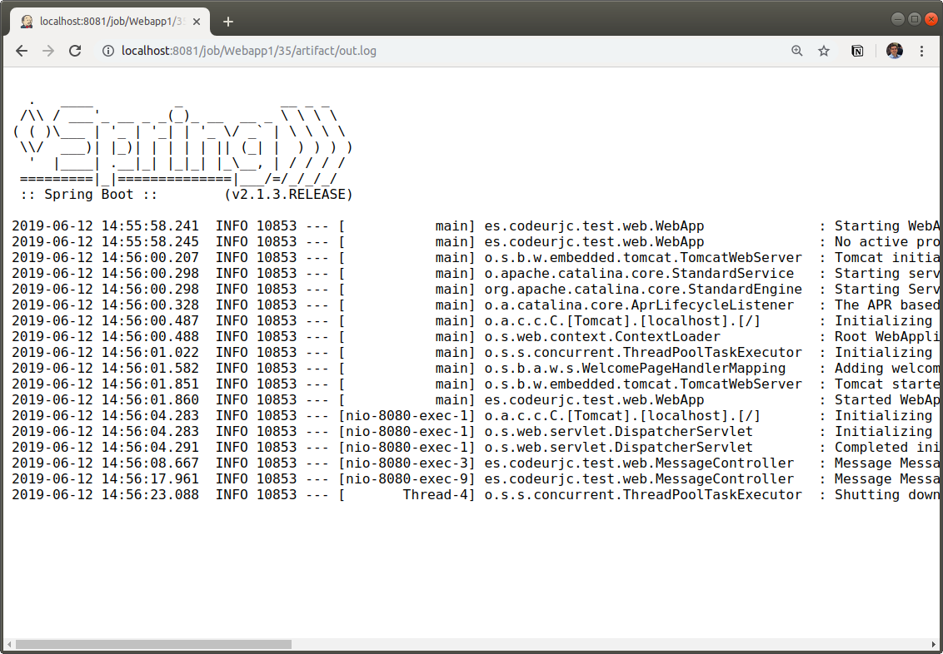
SUT Logs are available as a text files

Slide 39

SUT Logs are available as a text files
Which log entries are related to failed test?

Slide 40

SUT Logs are available as a text files

Slide 41
Logs management
We need tools to manage logs
  Put all logs in a single place
    Test logs and SUT logs
    Remote service to be used from SUT deployed in any place
  Advanced log analysis capabilities
    Filtering by test
    Searching
    Comparing executions (success vs fail)

Slide 42





Logs management
Elasticsearch
Kibana
Logstash
Beats
https://www.elastic.co/

Slide 43
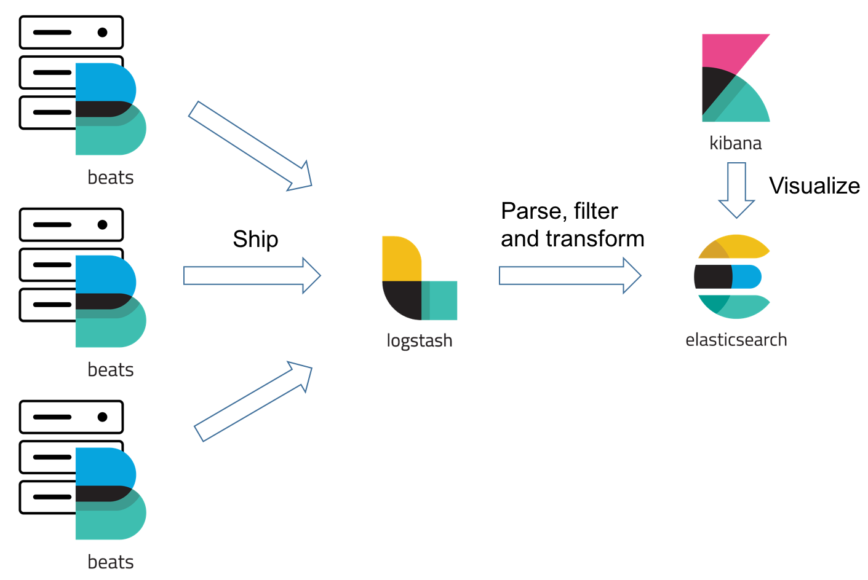
Logs management

Slide 44

Logs management
Open source earch engine based on Lucene
Full text search of JSON documents
Http client
Usually used to parse and analyze software logs
https://www.elastic.co/products/elasticsearch

Slide 45

Logs management
Data processing pipeline
Can ingest data from multiple sources
Parse and transform input data
Send results to ElasticSearch
https://www.elastic.co/products/logstash

Slide 46

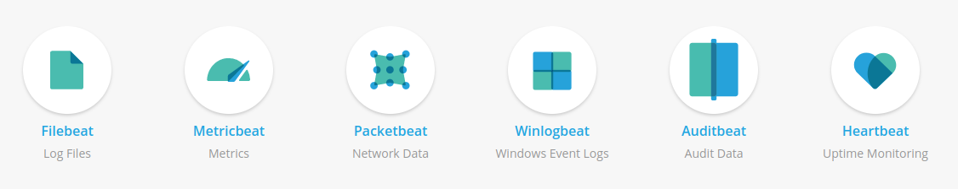
Logs management
Lightweight data Shippers
Send data to Logstash or ElasticSearch
https://www.elastic.co/products/beats

Slide 47

Logs management
Visualize ElasticSearc data
Can define custom dashboards with graphics
Filtering, search...
Can access to raw data stored
https://www.elastic.co/products/kibana

Slide 48
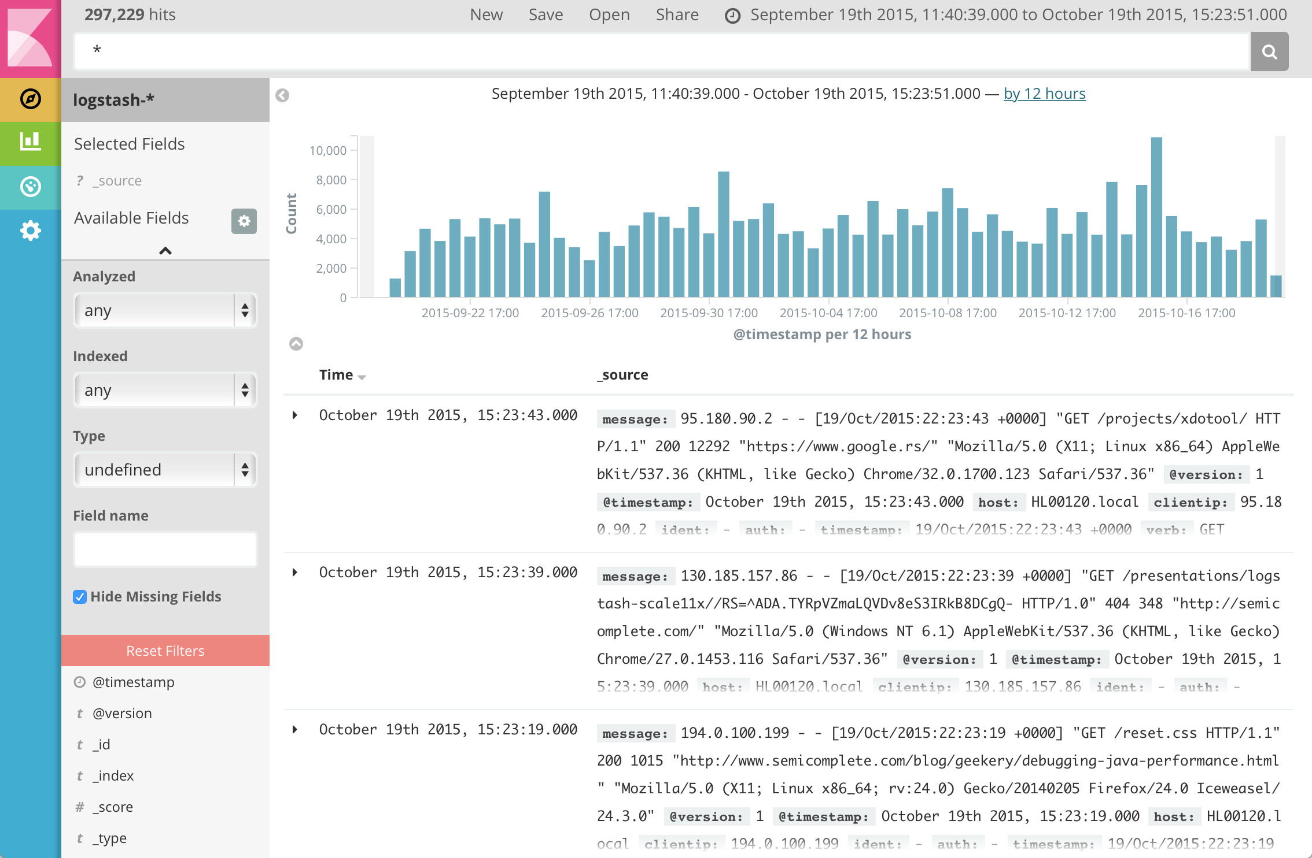
Logs management

Slide 49
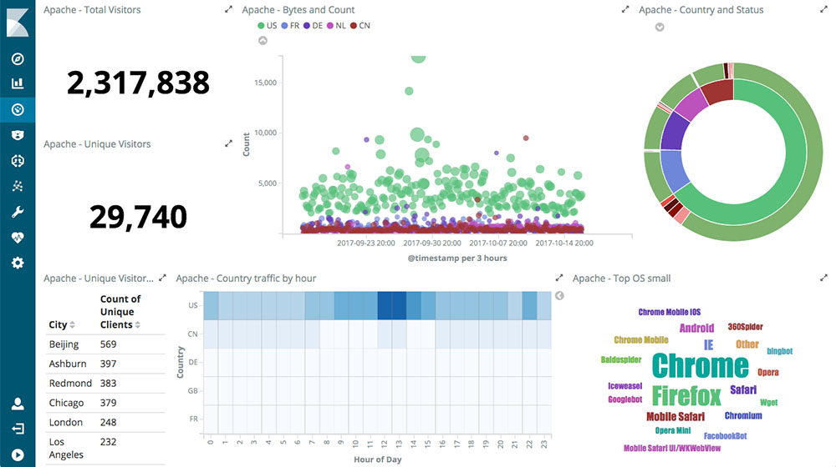
Logs management

Slide 50

Logs management
Logs &
metrics
Logs &
metrics
Java
Web app
container
Logs &
metrics
MySQL
container

Slide 51
Logs management
Install and configure Elastic tools to receive logs from Jenkins
  http://www.admintome.com/blog/logging-jenkins-jobs-using-elasticsearch-and-kibana/
  https://plugins.jenkins.io/logstash
Retrive logs from SUT
  Filebeat
  Log directly to ElasticSearc
    https://github.com/magrossi/es-log4j2-appender

Slide 52
Demo 2
Manage logs with Elastic stack
https://github.com/codeurjc/expoqa19/tree/demo2

Slide 53
Configurar ELK
logstash {
node {
try {
stage("Preparation") {
git(
url: 'https://github.com/codeurjc/expoqa19.git',
branch: "demo2"
)
}
stage("Create jar") {
sh "docker-compose build"
}
stage("Start app") {
sh "docker-compose up -d"
}
stage("Test") {
sh "mvn test"
}
} finally {
sh "docker-compose down"
junit "target/*-reports/TEST-*.xml"
}
}
}
https://github.com/codeurjc/expoqa19/blob/demo0/Jenkinsfile

Slide 54


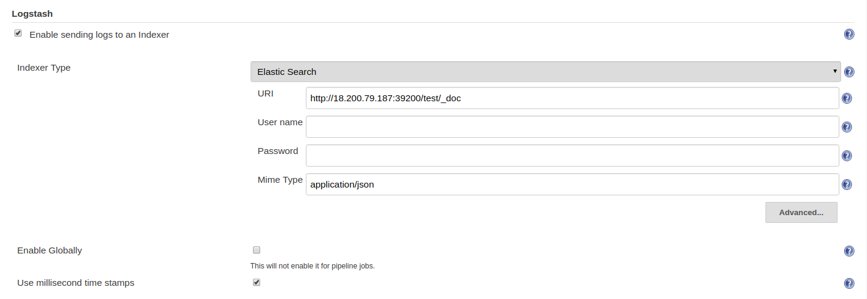
https://wiki.jenkins.io/display/JENKINS/Logstash+Plugin

Slide 55
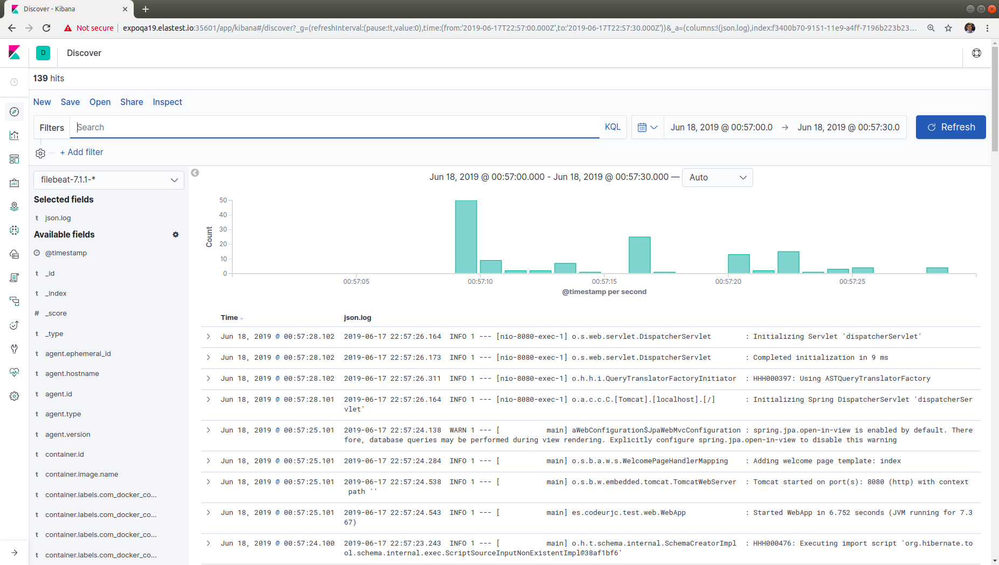

Slide 56
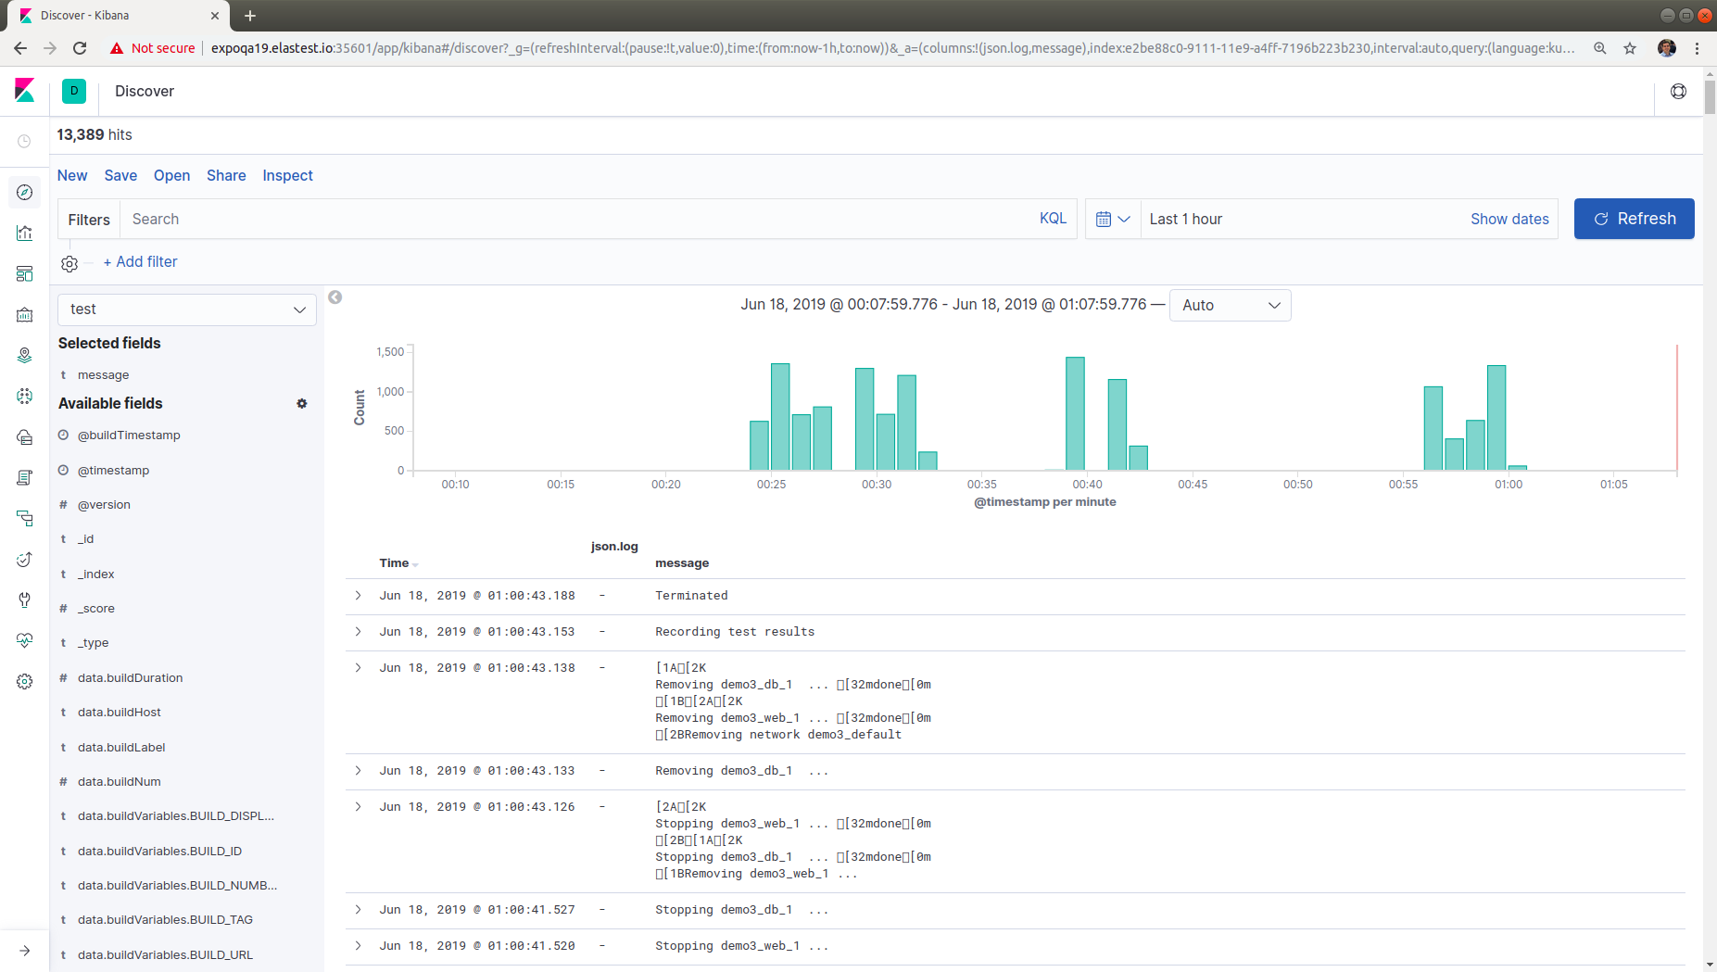

Slide 57
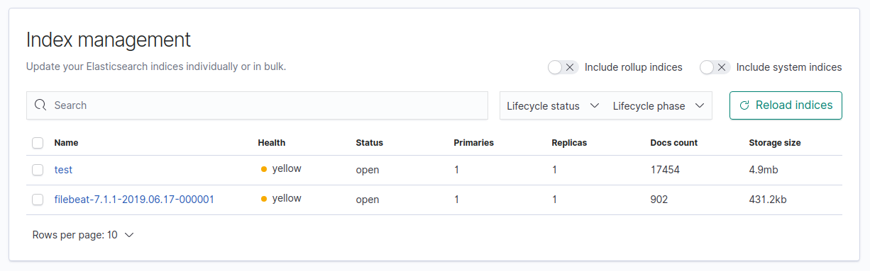

Slide 58
Are these observability tools designed for testing?
Is it easy to focus on information related to a failed test?

Slide 59
Logs management
Which log entries are related to failure?
Time filter?

Slide 60
Logs management
Is that the best tool to know why a test has failed?

Slide 61
Logs management
Kibana is a generic tool to visualize and query JSON documents
It is not designed specifically to log analysis
Example:
  You can filter results to only show ERROR log entries
  But if you can take a look to previous log entries, you have to search again to show all entries

Slide 62
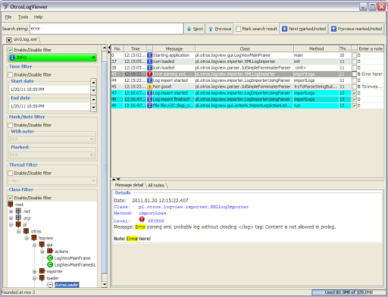
Logs management
OtrosLogViewer is a powerful log analysis tool

Slide 63
Logs management
OtrosLogViewer
  Is a tool that have to be installed locally
  Logs have to be opened from local text files or connecting to servers using FTP
  Can’t process huge log files (it loads all file in memory)
  It can not be used easily with CI systems
https://github.com/otros-systems/otroslogviewer

Slide 64
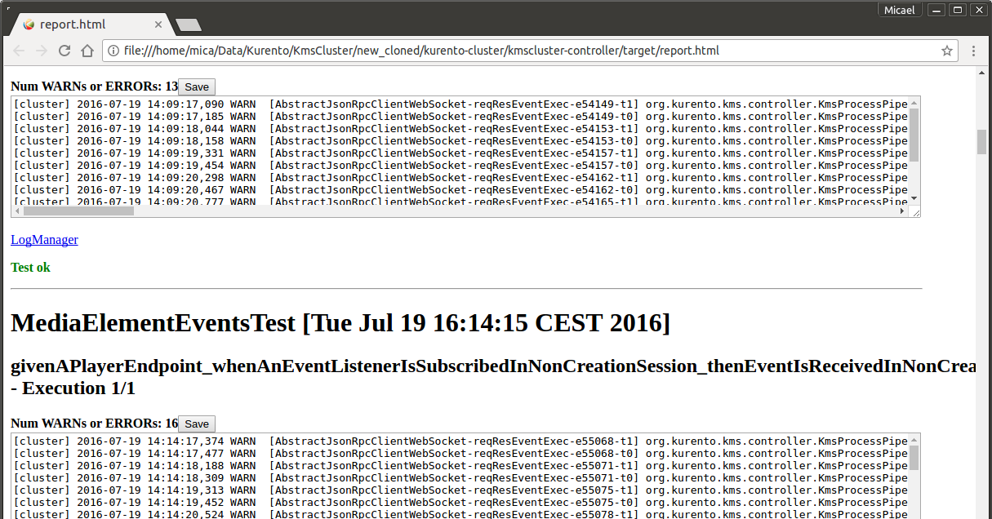
Logs management
What if a test wants to know if there are WARN messages in SUT logs ?

Slide 65
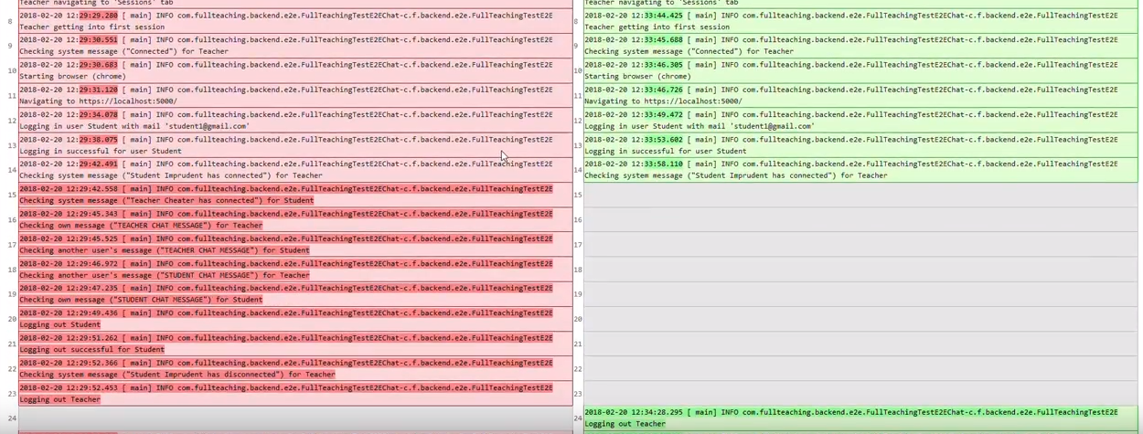
Logs management
It would be very useful to be able to compare the log of a failed test with previous sucess executions

Slide 66
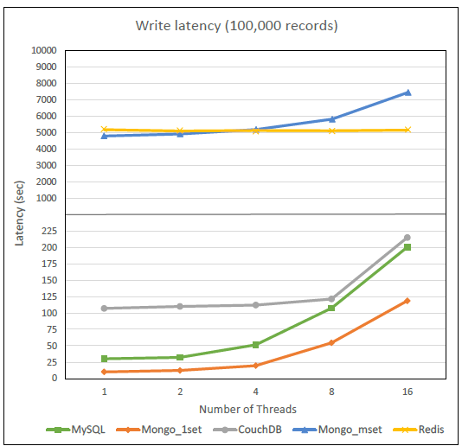
Metrics management
How difficult is compare metrics obtained with different technologies or parameters?

Slide 67

If SUT is a web application, the browser can help to know root cause of the problem when a system test fails

Slide 68

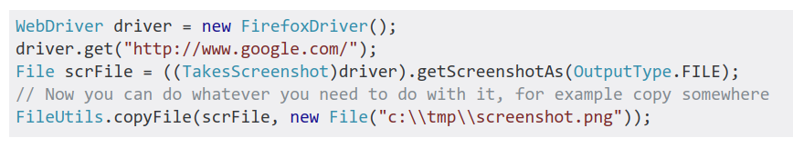
Web Testing
Selenium is the most used tool to manage browsers from tests
Tests can take screenshots of the browser while executing and archive for later inspection

Slide 69



Browser recording
There are services to record a video of the browser when tests are executed

Slide 70
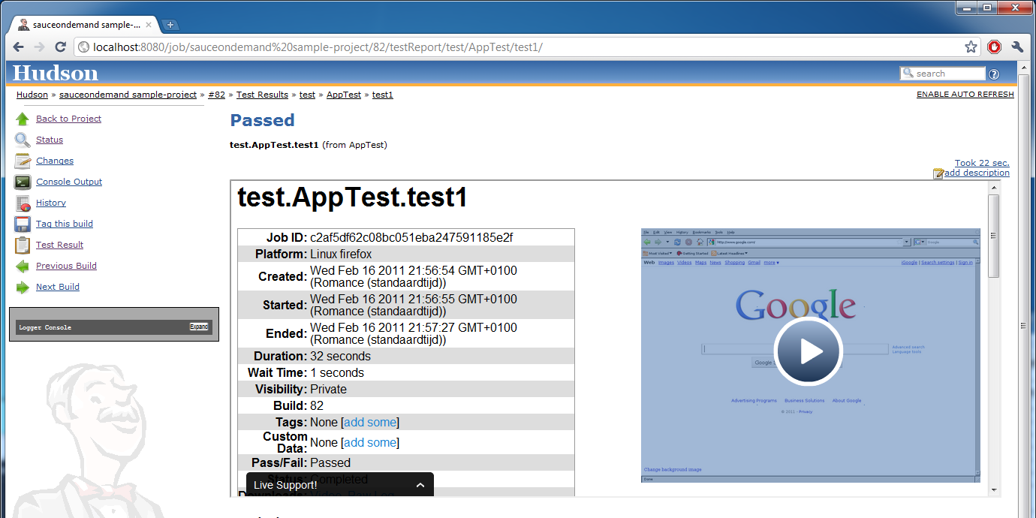
Browser recording

Slide 71

Browser recording
There are open source versions of these services based on docker
https://zalando.github.io/zalenium/

Slide 72
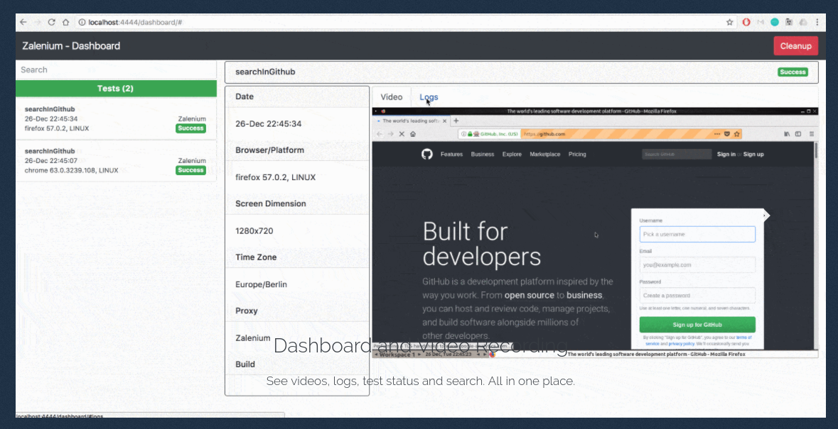
Browser recording
https://zalando.github.io/zalenium/

Slide 73

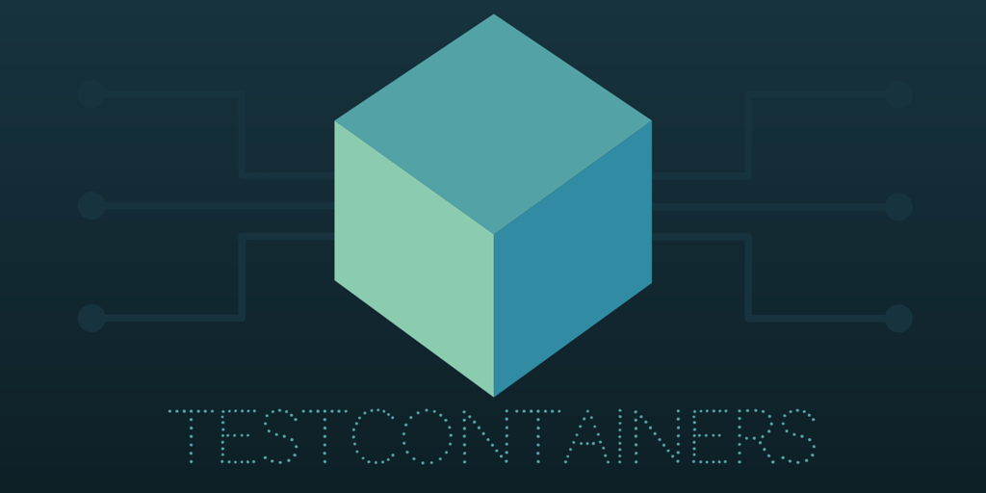
Browser recording
Also there are JUnit libraries with similiar features
JUnit 4
JUnit 5
https://www.testcontainers.org/
https://bonigarcia.github.io/selenium-jupiter/

Slide 74
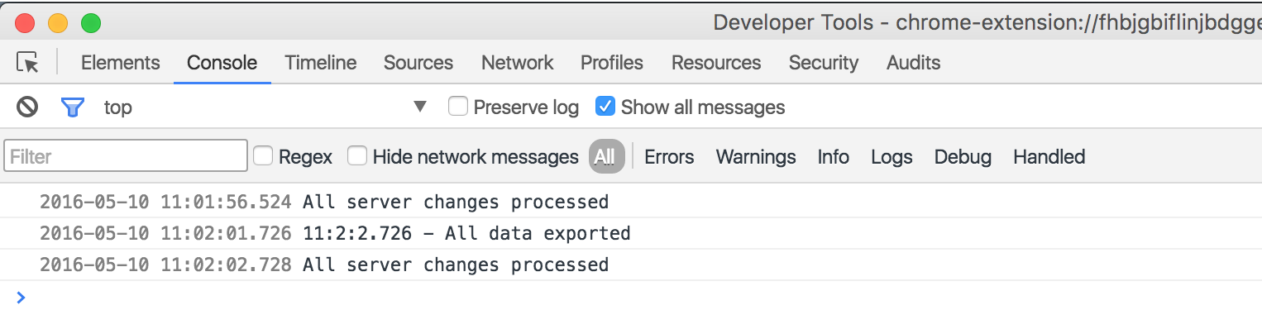
Limitations of browser recording
Browser videos are not synchronized with logs
Browser console is not registered with other logs (SUT logs, job logs...)

Slide 75
Demo 3
Dockerized browsers with
video recorded
https://github.com/codeurjc/expoqa19/tree/demo3

Slide 76
logstash {
node {
try {
stage("Preparation") { ... }
stage("Create jar") { ... }
stage("Start app") { ... }
stage("Test") {
sh "mvn test -Dsel.jup.recording=true -Dsel.jup.output.folder=surefire-reports"
}
} finally {
sh "docker-compose down"
step([$class: 'JUnitResultArchiver',
testDataPublishers: [[$class: 'AttachmentPublisher']],
testResults: '**/target/surefire-reports/TEST-*.xml'])
}
}
}
Configura la
Grabación de los
navegadores
Guarda vídeos de
navegadores
asociados a los
tests usando el
nombre de las
carpetas
https://github.com/codeurjc/expoqa19/blob/demo3/Jenkinsfile

Slide 77
@Test
public void createMessageTest(
@DockerBrowser(type = CHROME) RemoteWebDriver localDriver,
TestInfo info) throws InterruptedException, MalformedURLException {
this.driver = localDriver;
driver.get(sutURL);
LOG.info("Web loaded");
Thread.sleep(3000);
String newTitle = "MessageTitle";
String newBody = "MessageBody";
addMessage(newTitle, newBody);
String title = driver.findElement(By.id("title")).getText();
String body = driver.findElement(By.id("body")).getText();
assertEquals(newTitle, title);
assertEquals(newBody, body);
LOG.info("Message verified");
Thread.sleep(2000);
}
Uso de browser
Dockerizado con
Selenium Jupiter

Slide 78
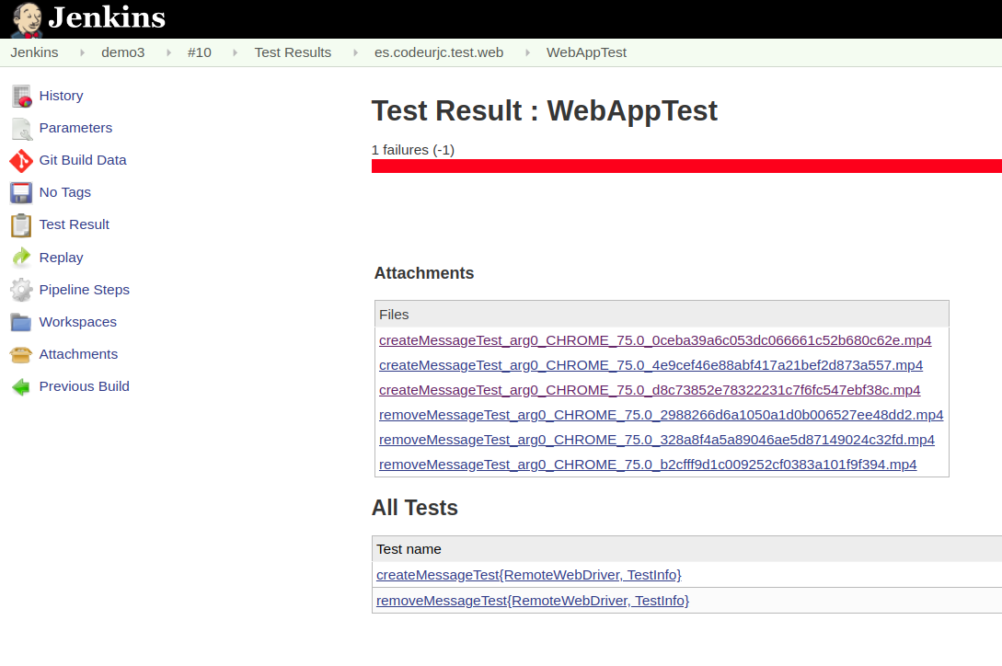

Slide 79
It is possible to improve observability of end to end testing of cloud native applications?

Slide 80


Slide 81

What is ElasTest?
Open source platform for E2E testing of cloud native applications
  Distributed and complex
  Containerized
https://elastest.io

Slide 82
What is ElasTest?
Main features
  Log and metrics visualization, recording and management
  Log/Metrics analysis and comparison
  Web browsers management
  Jenkins and TestLink integration

Slide 83
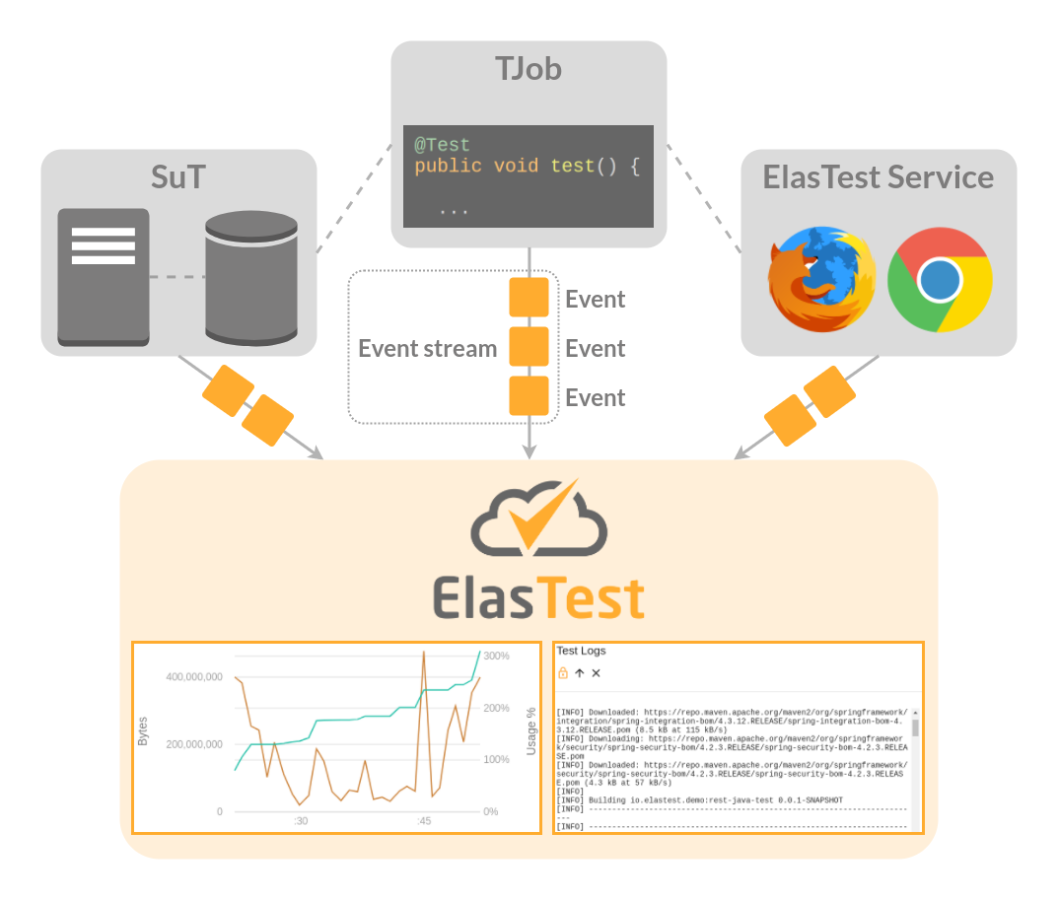

Slide 84

Features
Works with your current tests & Jenkins jobs
  With any programming language
  With any testing framework
  With your usual tools like selenium

Slide 85
Minimal code changes
Log test start and end
public class BaseTest {
protected static final Logger logger = LoggerFactory.getLogger(ElasTestBase.class);
@Rule
public TestName name = new TestName();
@Before
public void logStart() {
logger.info("##### Start test: " + name.getMethodName());
}
@After
public void logEnd() {
logger.info("##### Finish test: " + name.getMethodName());
}
}

Slide 86
Minimal code changes
Create Selenium browsers with the remote URL
specified in an environment variable provided by ElasTest
public class BaseTest {
@Before
public void setupTest() throws MalformedURLException {
String eusURL = System.getenv("ET_EUS_API");
if (eusURL == null) {
// Local Google Chrome
driver = new ChromeDriver();
} else {
// Selenium Grid in ElasTest
driver = new RemoteWebDriver(new URL(eusURL), chrome());
}
}
}

Slide 87
Demo 4
Testing with ElasTest
https://github.com/codeurjc/expoqa19/tree/demo4

Slide 88
node {
elastest(
tss: ['EUS'], monitoring: true, project: 'ExpoQA19'
surefireReportsPattern: '**/target/surefire-reports/TEST-*.xml', ) {
try {
stage("Preparation") {
git(
url: 'https://github.com/codeurjc/expoqa19.git',
branch: "demo4"
)
}
stage("Create jar") {
sh "docker-compose build"
}
stage("Start app") {
sh "docker-compose -p ${env.ET_SUT_CONTAINER_NAME} up -d"
}
stage("Test") {
sh "mvn test"
}
} finally {
sh "docker-compose -p ${env.ET_SUT_CONTAINER_NAME} down"
junit "target/*-reports/TEST-*.xml"
}
}
}
ElasTest configuration
Start app
SUT Indentification
https://github.com/codeurjc/expoqa19/blob/demo4/Jenkinsfile

Slide 89
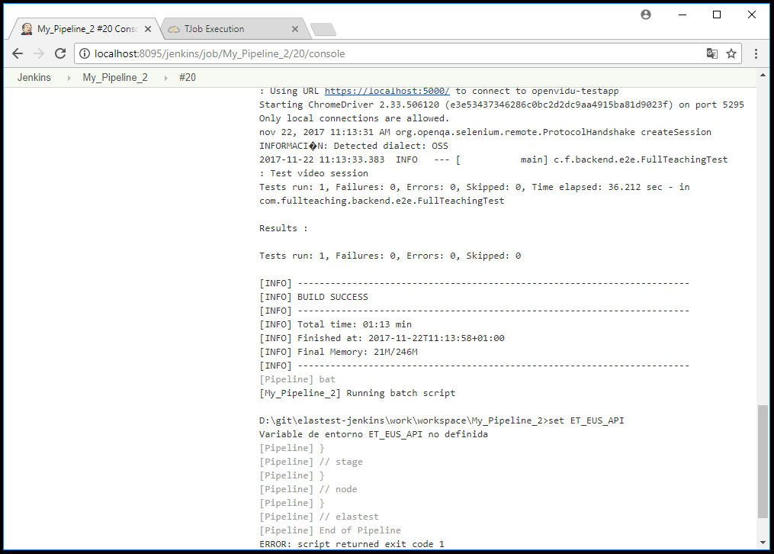
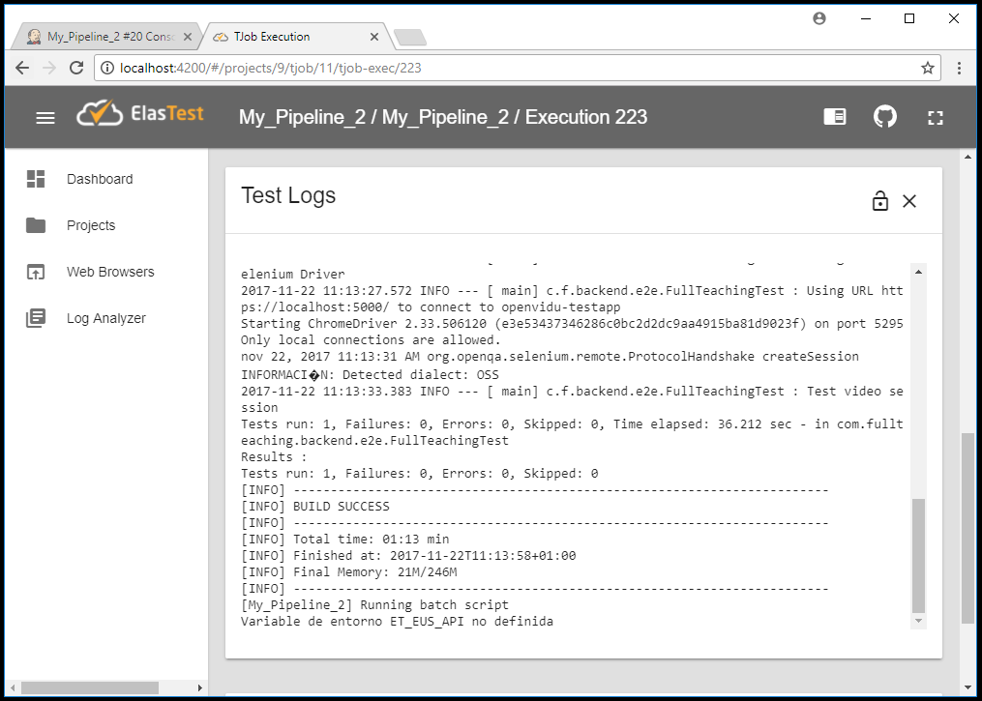

Log management
Job logs are managed in ElasTest

Slide 90
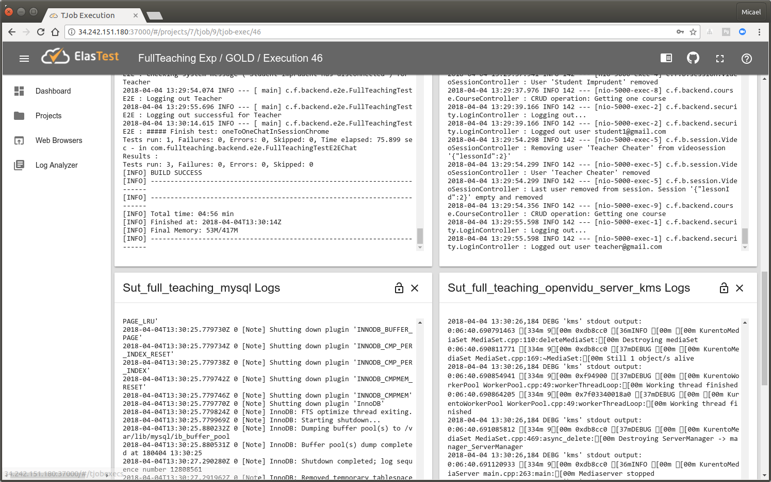
Logs for different SUT components...

Slide 91
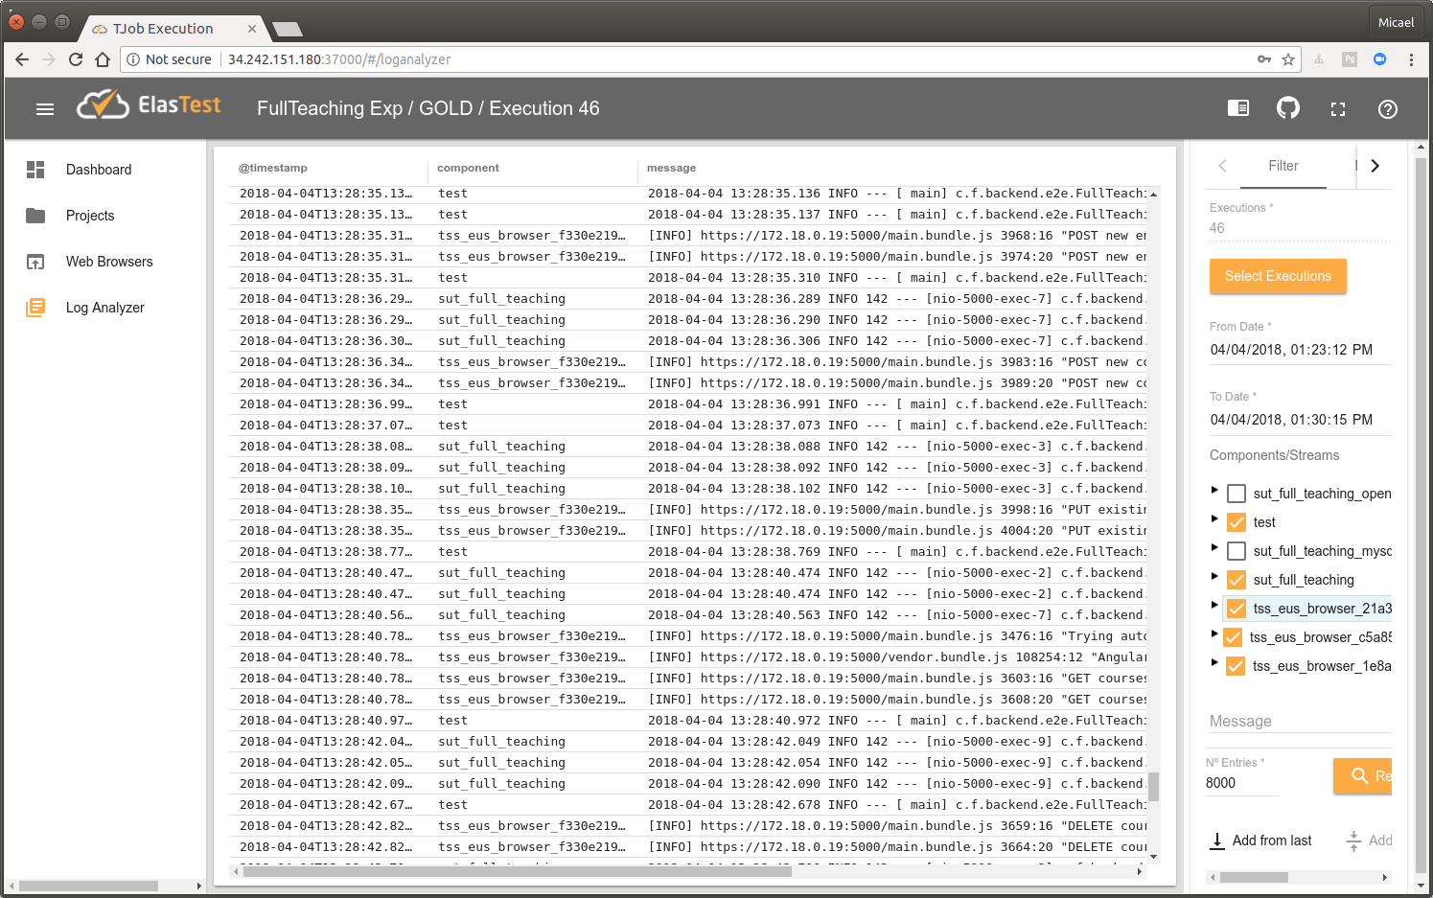
Log Analyzer
All logs in the same place (Job, Tests, browser console, SUT components)

Slide 92
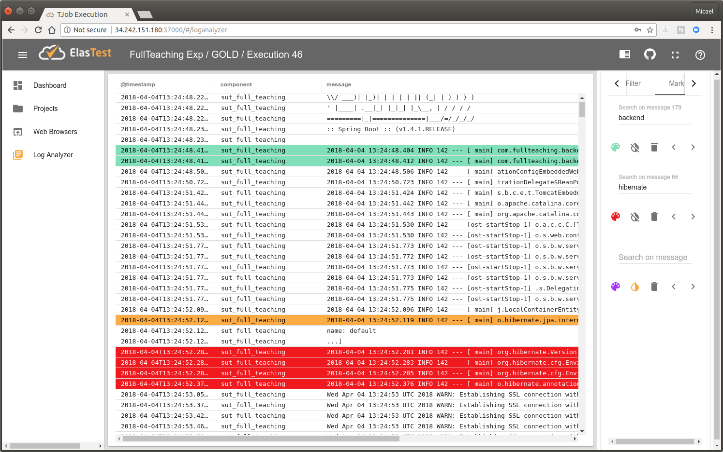
Log Analyzer
Search, filter, mark, per test, per SUT component...

Slide 93
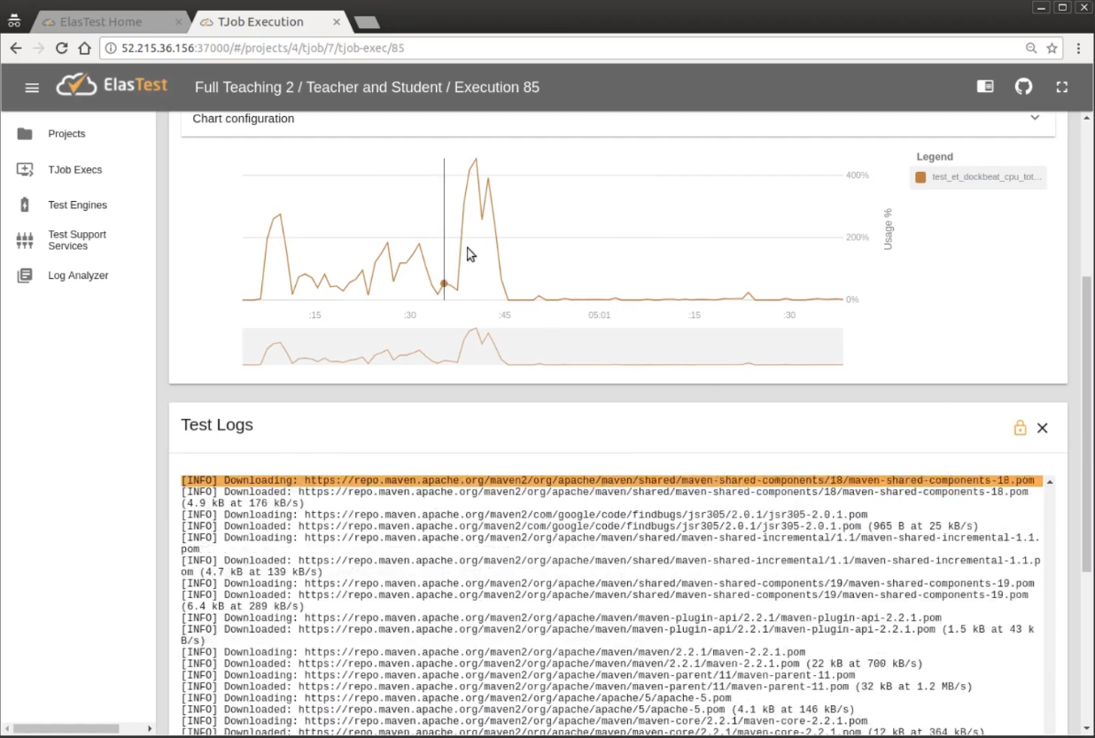
Log and metrics integration

Slide 94
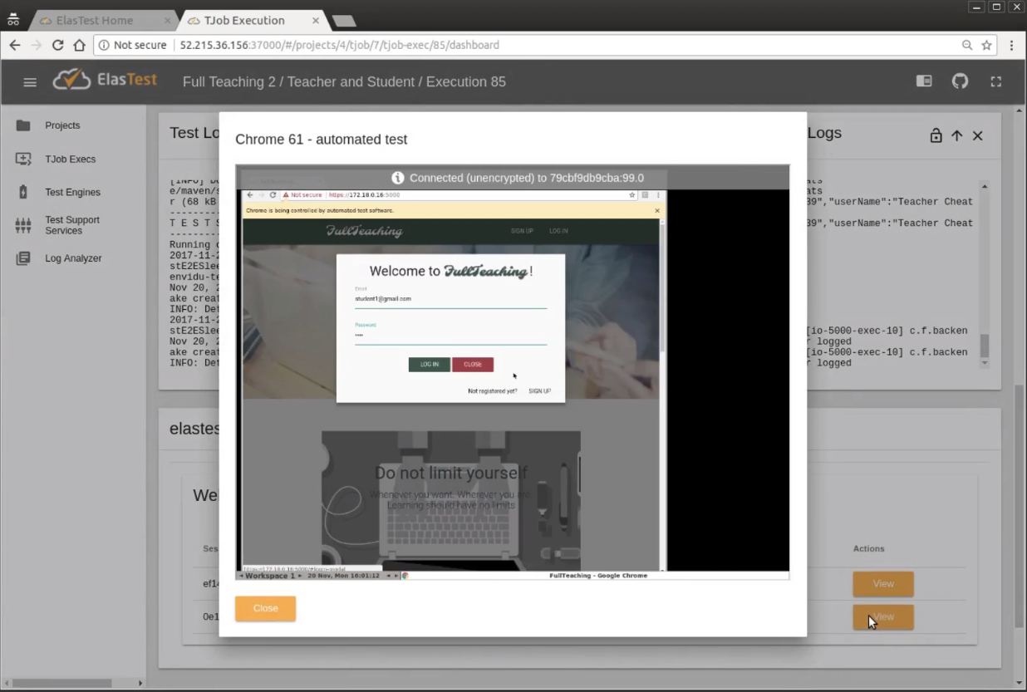
Web browsers

Slide 95


Slide 96
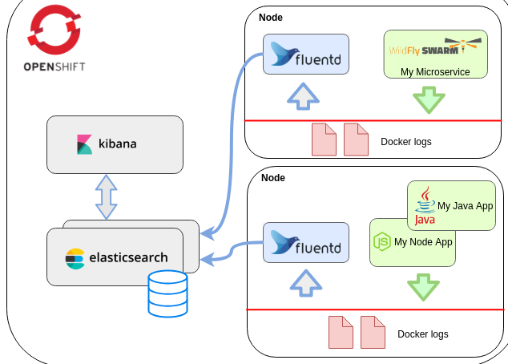

Logs

Slide 97
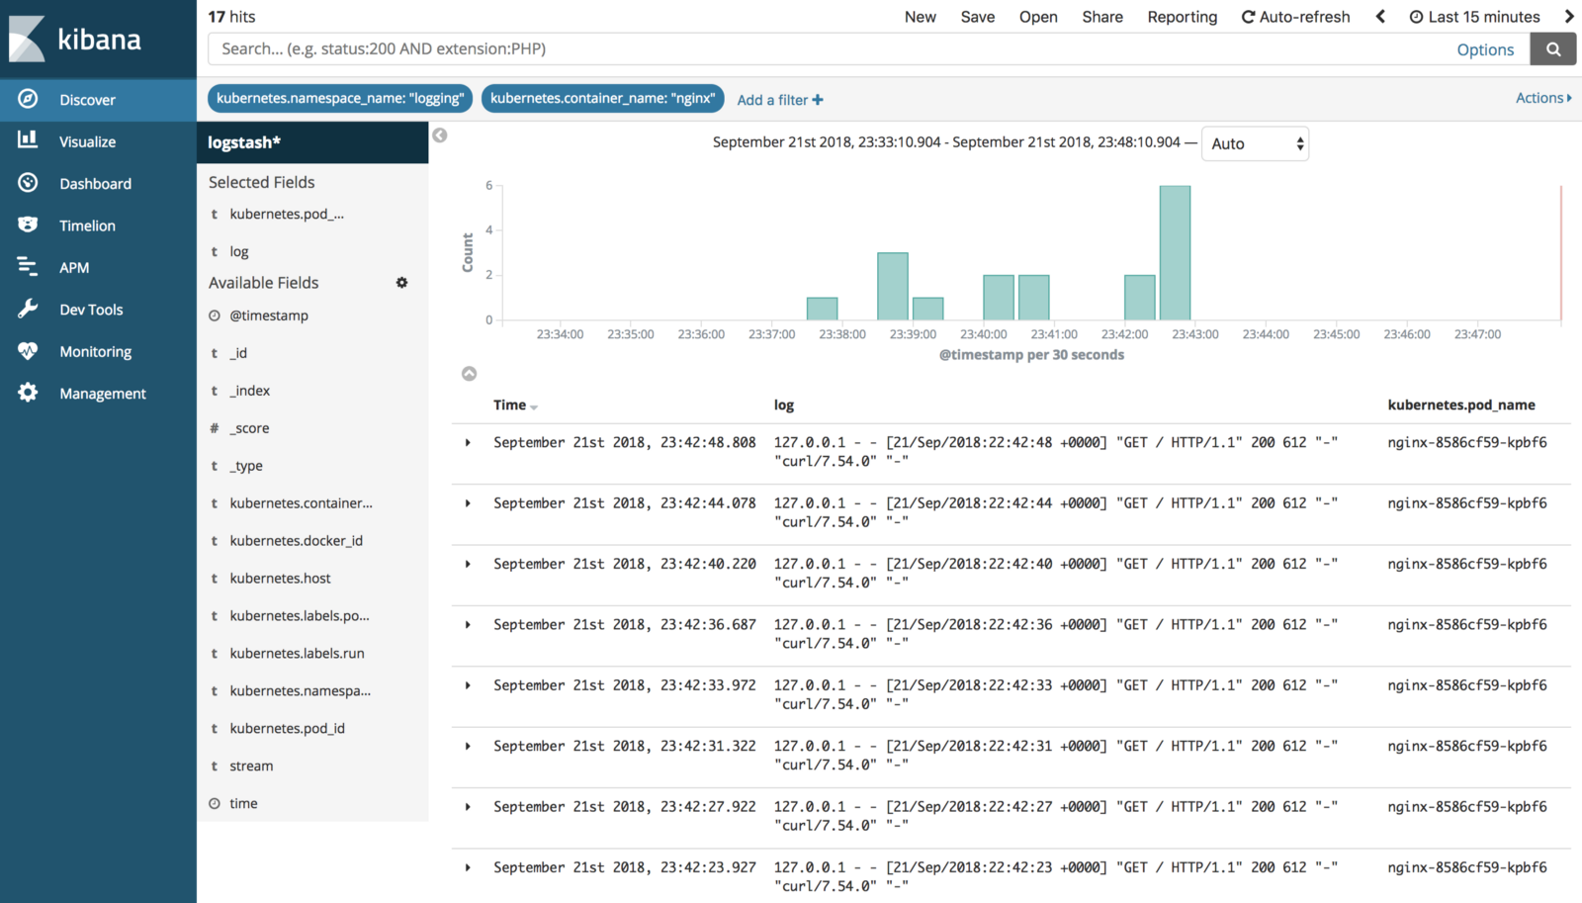
Logs

Slide 98
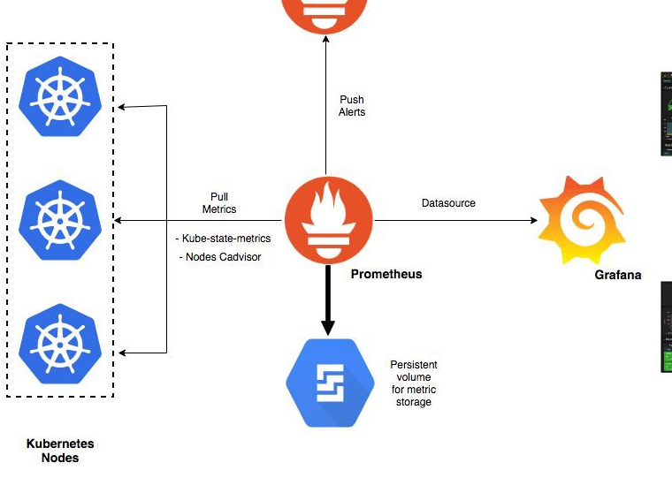
Metrics

Slide 99
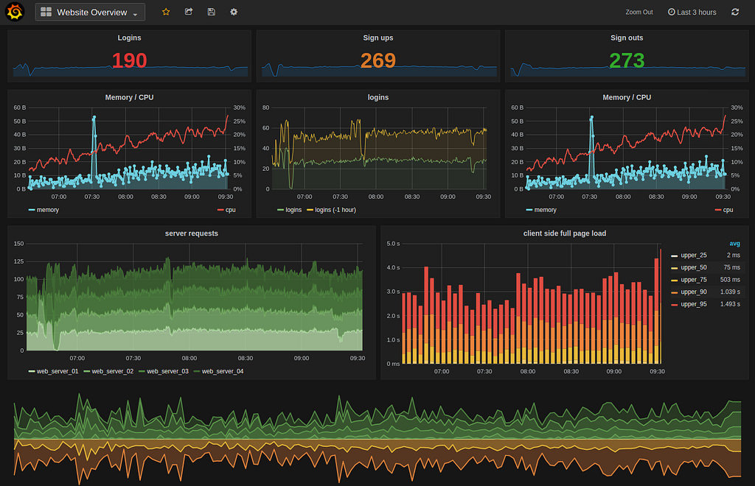
Metrics

Slide 100
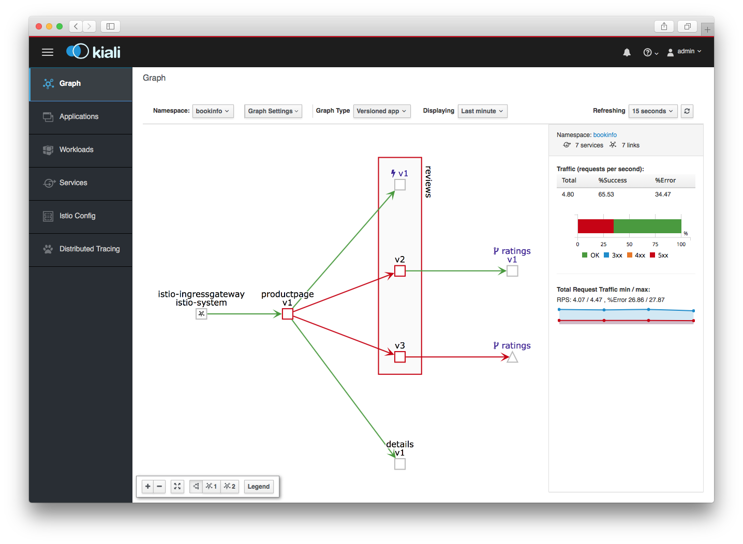
Network traffic

Slide 101
Demo 5
Testing Kubernetes apps
with ElasTest
https://github.com/codeurjc/expoqa19/tree/demo5

Slide 102
node {
elastest(
tss: ['EUS'], monitoring: true, project: 'ExpoQA19'
surefireReportsPattern: '**/target/surefire-reports/TEST-*.xml', ) {
withKubeConfig([credentialsId: 'K8S_TOKEN', serverUrl: '${K8S_URL}']) {
try {
stage("Preparation") {
git(
url: 'https://github.com/codeurjc/expoqa19.git',
branch: "${BRANCH}"
)
}
stage("Create jar") {
sh "docker build . -t expoqa19/webapp2:v1"
}
stage("Start app") {
sh "./addSutPrefix.sh"
sh "kubectl create -f k8s/"
}
stage("Test") {
sh "mvn test"
}
} finally {
sh 'kubectl delete -f k8s/'
junit "target/*-reports/TEST-*.xml"
}
}
}
}
ElasTest configuration
SUT Indentification
https://github.com/codeurjc/expoqa19/blob/demo5/Jenkinsfile

Slide 103
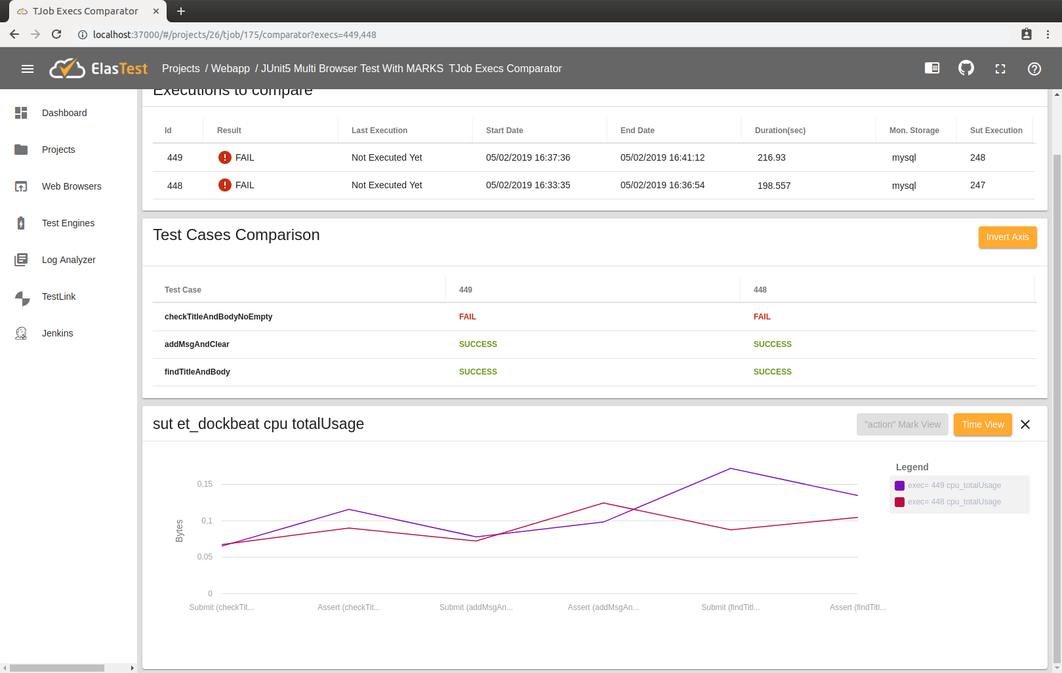
Tests comparison

Slide 104
Tests comparison
Test Results

Slide 105
Tests comparison
Tests metrics

Slide 106
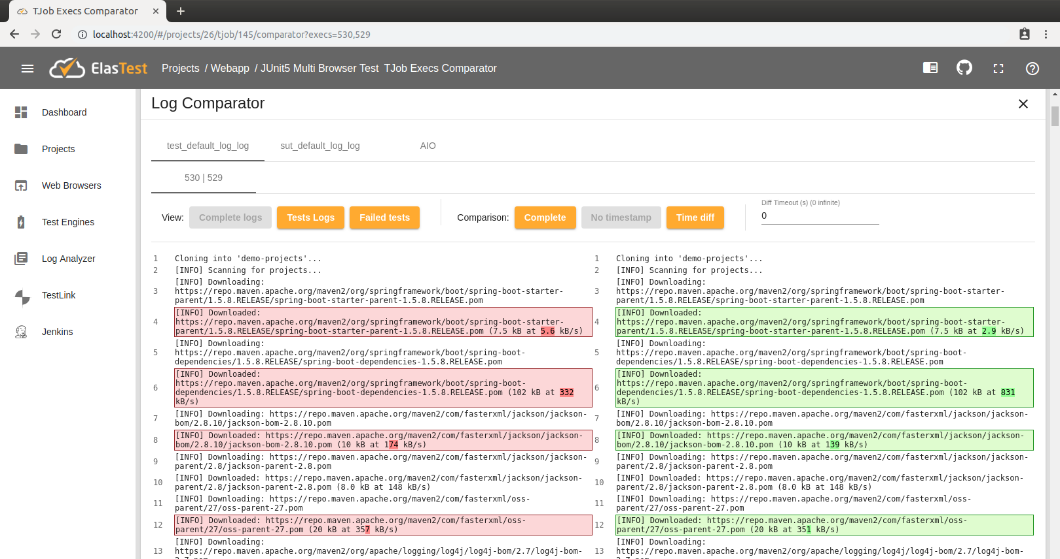
Tests comparison
Logs

Slide 107
Conclusions

Slide 108
Conclusions
Cloud native apps are complex distributed applications
More difficult to E2E test than monoliths (distributed systems falacies)
Observability during E2E testing is key

Slide 109
Conclusions
Observability in production
!=
Observability for E2E testing

Slide 110



Conclusions

Slide 111

Testing cloud and kubernetes applications
Micael Gallego &
Patxi Gortázar

Slide 112


How to use it?
> docker run … elastest/platform start
+
https://wiki.jenkins.io/display/JENKINS/ElasTest+Plugin

